Slide 1

Vinayak Pujare Linux & AWS Operations Engineer

Slide 2

Current Responsibilities Overview
Linux & AWS deployments
System troubleshooting
Patching activities
Installation, configuration, and maintenance of Linux-based systems and AWS cloud infrastructure. This includes setting up new environments, configuring security settings, and ensuring optimal performance of deployed applications.
Efficiently diagnosing and resolving infrastructure issues across various environments, including identifying root causes, implementing fixes, and documenting solutions for future reference. This also involves collaborating with other teams to ensure minimal downtime.
This includes scheduling patching windows, testing updates in staging environments, and monitoring systems post-patching to ensure stability and security compliance.
Patched 50+ EC2 instances with the latest security updates and bug fixes.

Slide 3
OS Migration Project Highlights
Migration Scope
Collaboration
Amazon Linux 2 to Amazon Linux 2023
Coordinated seamlessly with application teams
90+ EC2 instances migrated
for suitable OS components and Application
Decommissioning of old instances
dependencis.

Slide 4

Terraform Drift Fix Activity
Purpose
Addressed configuration drift in infrastructure
Tools Used
Hyperportal tool for management and automation
Scope
Fixed drift on 50+ EC2 instances
Outcome
Smooth update experience for EC2 pipeline.

Slide 5

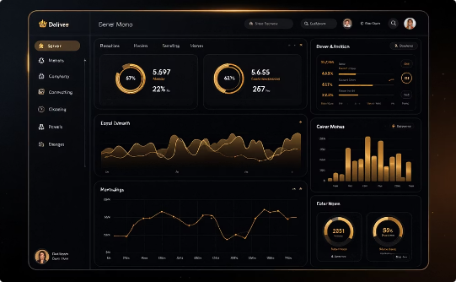

Disaster Recovery Setup
DR Configuration
Monitoring
High Availability
Replication of critical systems across multiple AWS accounts for robust disaster recovery.
Continuous monitoring of replication status to ensure timely issue detection and resolution.
Designed for seamless synchronization and resilience, ensuring minimal downtime during unforeseen events.

Slide 6




AWS Cost Optimization Strategies
Instance Downgrading
Reduced costs by right-sizing EC2 instances
EBS-Optimized Storage
Recommended for performance and cost efficiency
Storage Migration
Moved data from EFS to S3 to reduce expenses

Slide 7
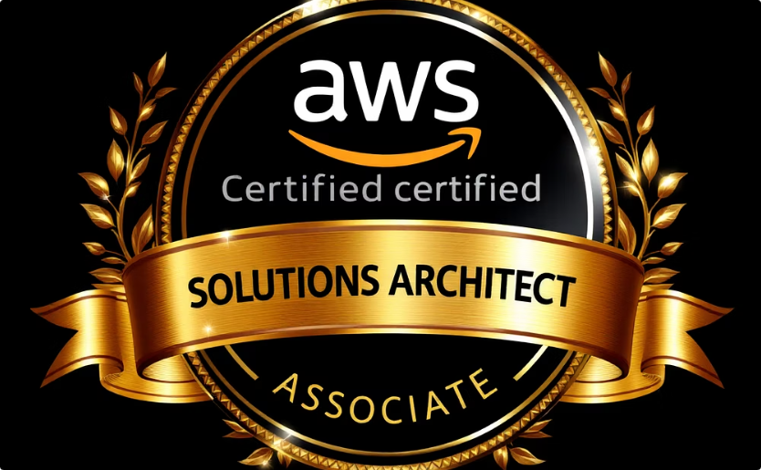
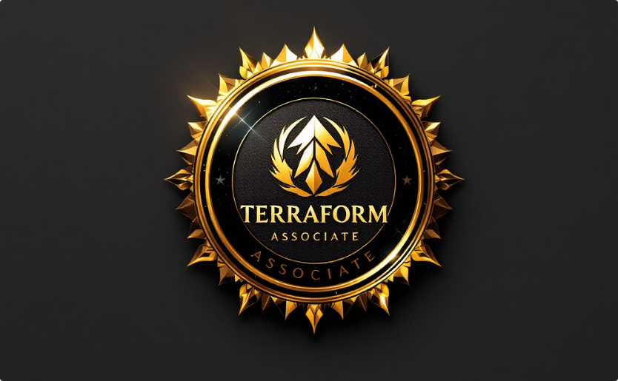
Certifications Achieved
AWS Solutions Architect Associate
Terraform Associate
July 2024
January 2025

Slide 8



Future Professional Goals
Docker Skills
1
Master containerization technologies
Kubernetes Expertise
Learn orchestration and cluster management
DevOps Tools
Focus on GIT, Terraform, Ansible, monitoring tools

Slide 9
Thank You
Thank you for your time and consideration!

